Slide 1
NOVOSIBIRSK
STATE
UNIVERSITY
Introduction to
Machine Learning
Ahsan Shakoor
Machine Learning
2026
Novosibirsk State University

Slide 2

Course Overview
Instructor: Ahsan Shakoor
Novosibirsk State University
Course: Machine Learning, November–December 2026
GitHub: github.com/Ahsan-ShakoorK/NSU_ML
Theory and practical labs
Assignments and a personal final project

Slide 3

You drive to campus every day, but winter snow
often changes how long the trip takes.
2

Slide 4

Can you predict how long your next trip will take
if the snow is 40 mm deep?
Snow (mm) | Time (minutes)
0 | 10
5 | 11
10 | 12
15 | 13
20 | 14
40 | ?
3

Slide 5

You are developing a university app that tracks each student’s
study hours to help identify those at risk of failing.
4

Slide 6

Can you use this data to predict whether a student
will pass or fail the exam?
Study hours | Attendance (%) | Pass/Fail
27 | 45 | F
30 | 65 | P
23 | 80 | P
19 | 70 | P
25 | 50 | F
29 | 49 | ?
5

Slide 7

You own a fruit shop in the Главный Рынок and want to organize
your display so that similar fruits are placed close together,
so that you can serve your customers better.
6

Slide 8

Can you group the fruits into natural clusters to make it easier
for customers to choose and improve your sales?
Fruit | Color | Sweetness
Apple | Red | 7
Pear | Green | 7
Banana | Yellow | 9
Lemon | Yellow | 1
Watermelon | Green | 9
Avocado | Green | 3
7

Slide 9

ML Algorithm
An algorithm is a step-by-step set of instructions that tells
a computer how to solve a problem or complete a task.
A machine learning algorithm learns patterns from data
during training and uses them to make predictions
or decisions on new inputs.
8

Slide 10

Data preparation
Clean, explore, and understand data
Visualize data
What you’ll learn
Work with ML algorithms
Theory
Practice with scikit-learn
Evaluation
Test and compare
Improve models
9

Slide 11

How to pass
Lecture sessions and practical labs
Assignments, midterm, final project, and final exam
Course details and grading:
github.com/Ahsan-ShakoorK/NSU_ML
10

Slide 12
Get to
know
Machine
Learning
11

Slide 13
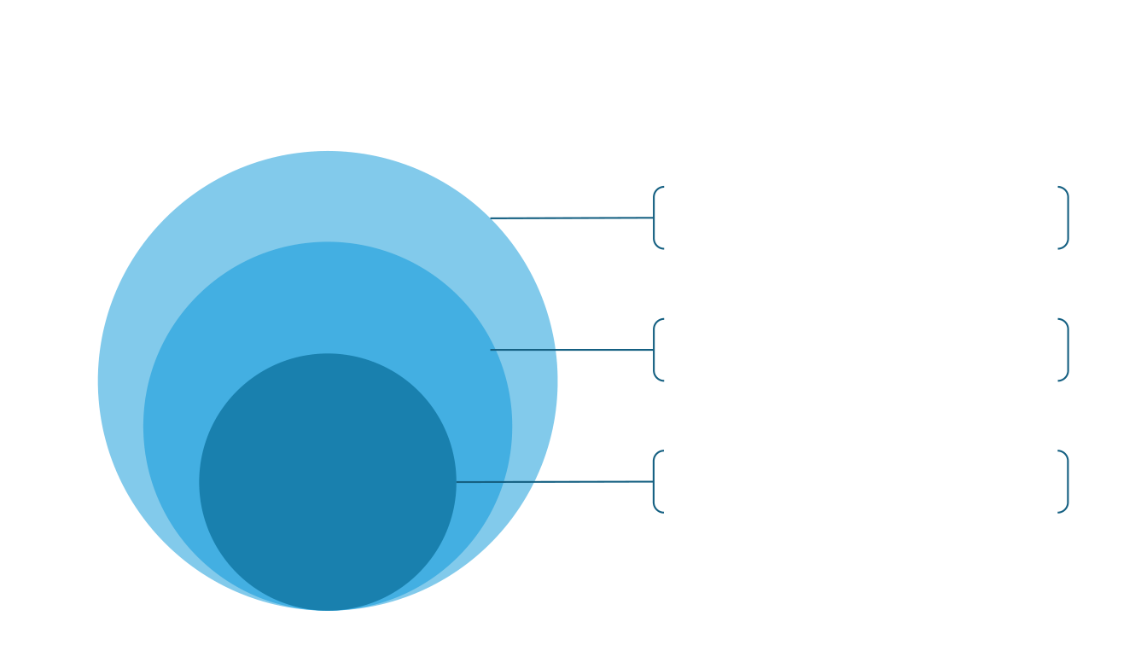
What is machine learning?
Artificial Intelligence
The broad field of creating systems that mimic
human intelligence to perform tasks
autonomously
Machine Learning
A subset of AI that learns patterns from data
during training, rather than requiring an explicit
rule for each individual prediction
A specialized area of ML that uses neural
Deep Learning
networks with multiple layers to model complex
patterns.
12

Slide 14
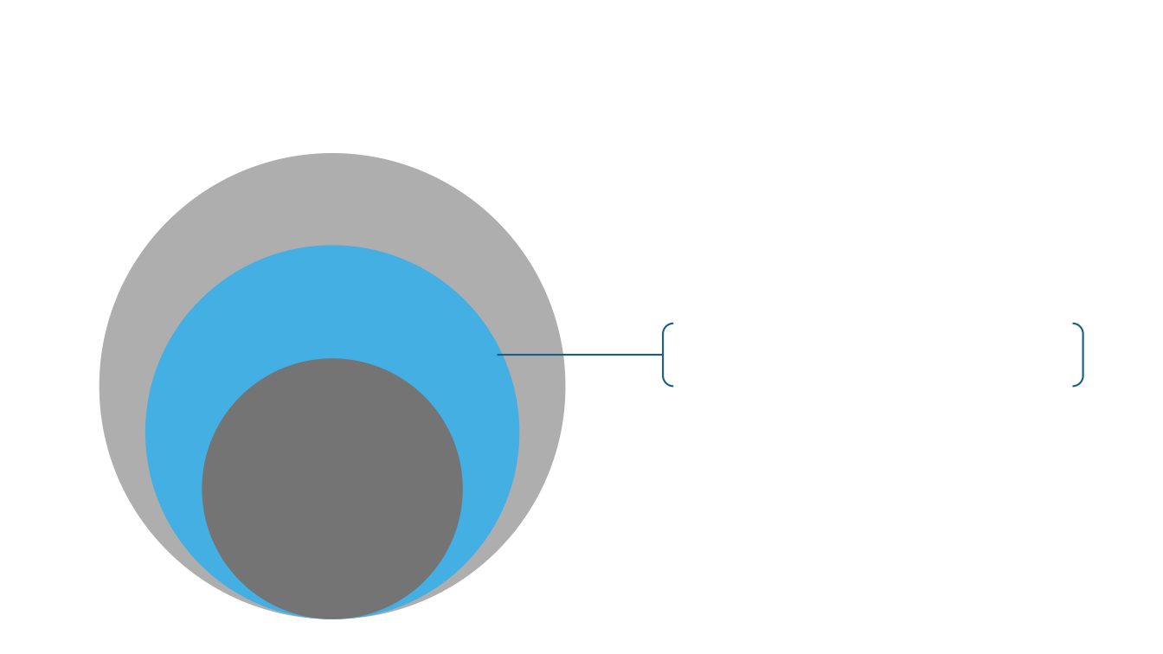
What is machine learning?
Machine Learning
A subset of AI that learns patterns from data
during training, rather than requiring an explicit
rule for each individual prediction
13

Slide 15
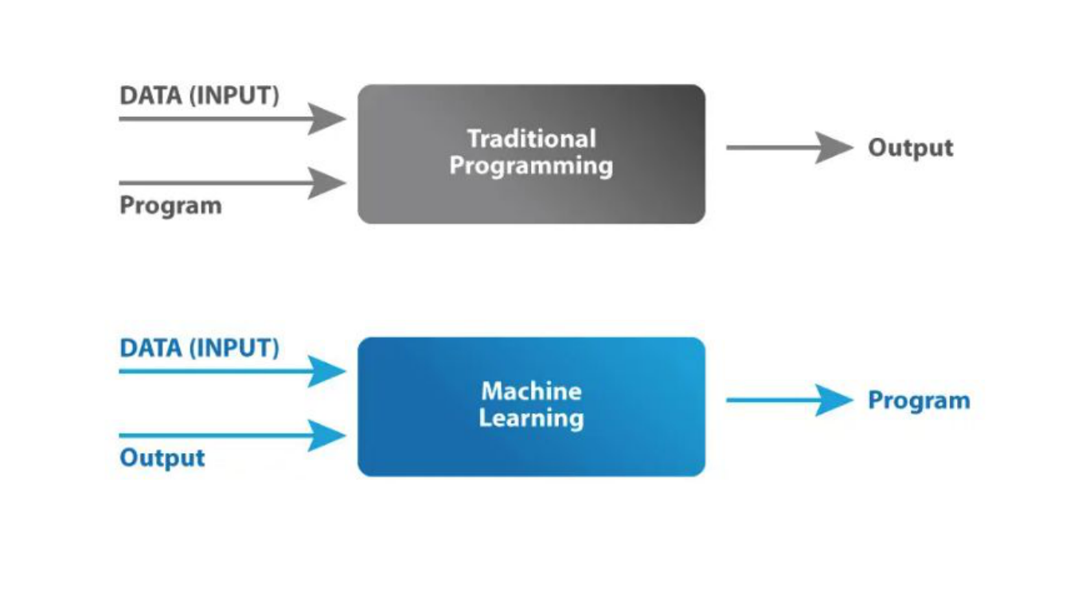
Source: https://www.mygreatlearning.com/blog/what-is-machine-learning/
14

Slide 16
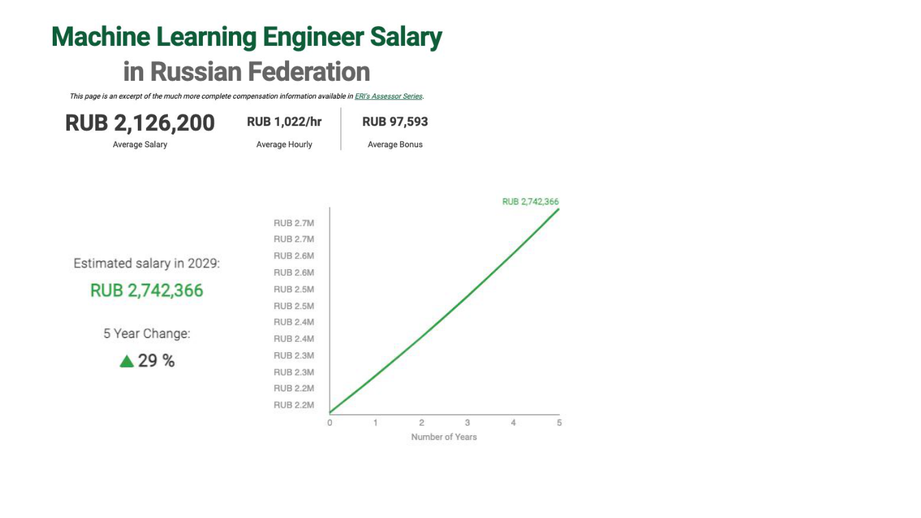
Job titles
• Machine Learning Engineer
• Data Scientist
• Research Scientist (Machine
Learning)
• Applied Machine Learning
Scientist
• Machine Learning Analyst
• Lead Machine Learning
Scientist
• Director of Machine Learning
• Chief AI Oﬃcer
Historical example from the source lecture (2025)
Source: https://www.erieri.com/salary/job/machine-learning-engineer/russian-federation
15

Slide 17

Applications of machine learning
Healthcare
Finance
E-commerce
Manufacturing
Transport and
Logistics
16

Slide 18
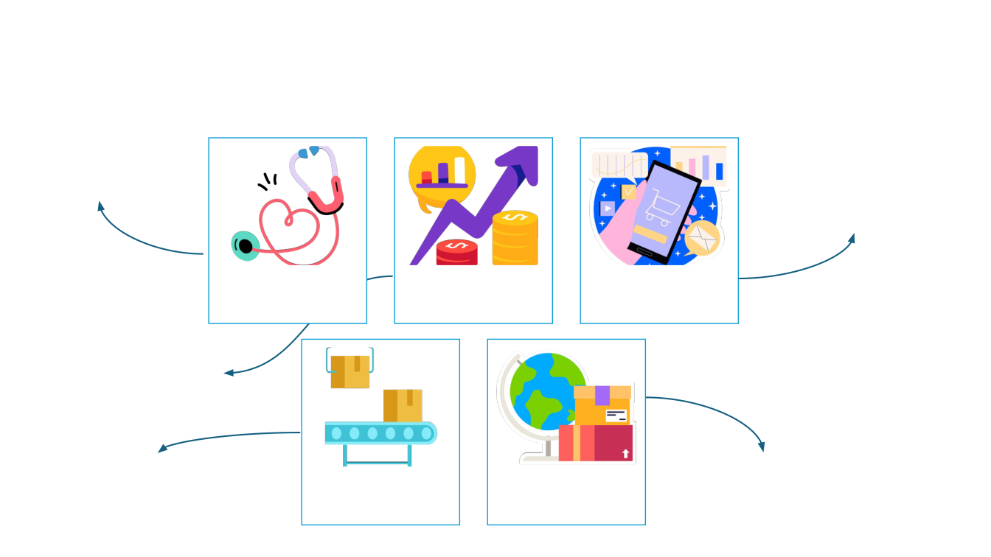
Applications of machine learning
- Diagnostics
- Predictive Analytics
- Personalized Medicine
- Recommendation Engines
- Customer Segmentation
- Inventory Management
Healthcare
Finance
E-commerce
- Fraud Detection
- Credit Scoring
- Algorithmic Trading
- Predictive Maintenance
- Route Optimization
- Quality Control
Manufacturing
Transport and
- Traﬃc Prediction
- Supply Chain Optimization
Logistics
17

Slide 19

Which ML applications
interest you?
Each student: suggest an idea for using ML to solve a
problem. Just raw ideas, do not think too much about
feasibility.
18

Slide 20
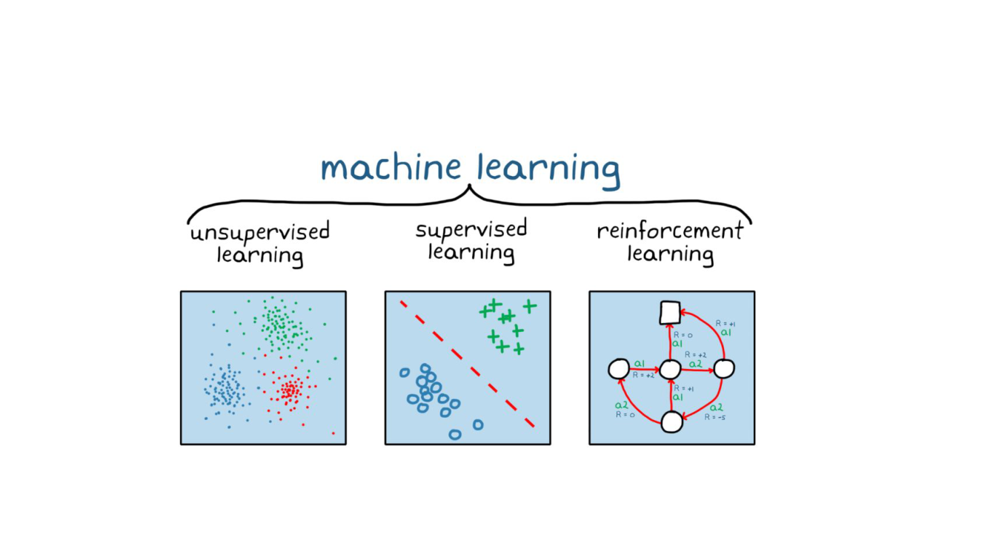
Types of machine learning
Unlabeled data
Find hidden structure
Labeled examples
Predict values or classes
Actions and rewards
Learn a decision policy
19
Source: theaiops.com/machine-learning-compare-supervised-learning-vs-unsupervised-learning-vs-reinforcement-learning/

Slide 21
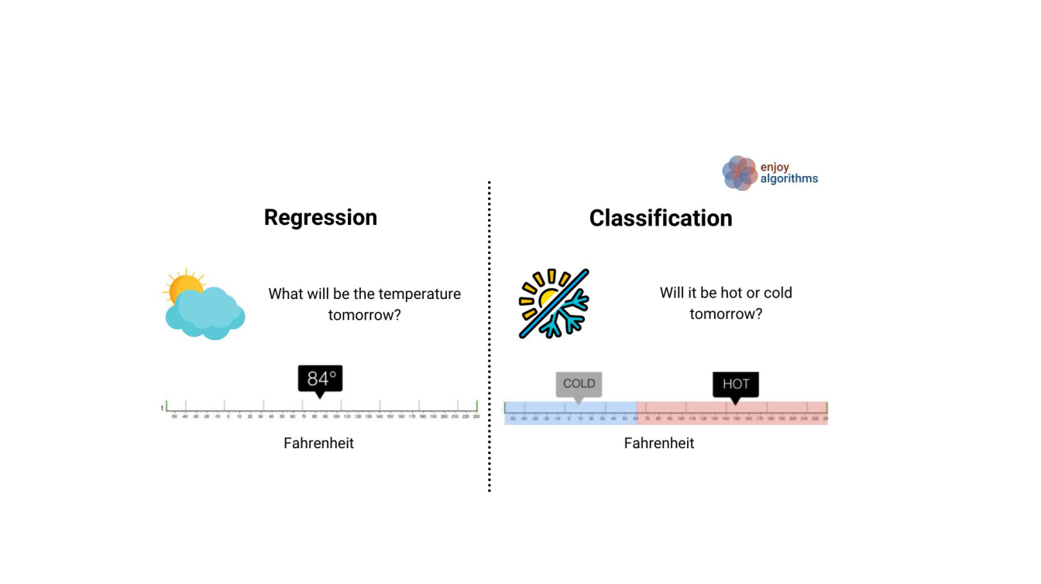
Types of Supervised Learning
Binary/
Multi-class
Source: https://www.enjoyalgorithms.com/blogs/classification-and-regression-in-machine-learning
20

Slide 22
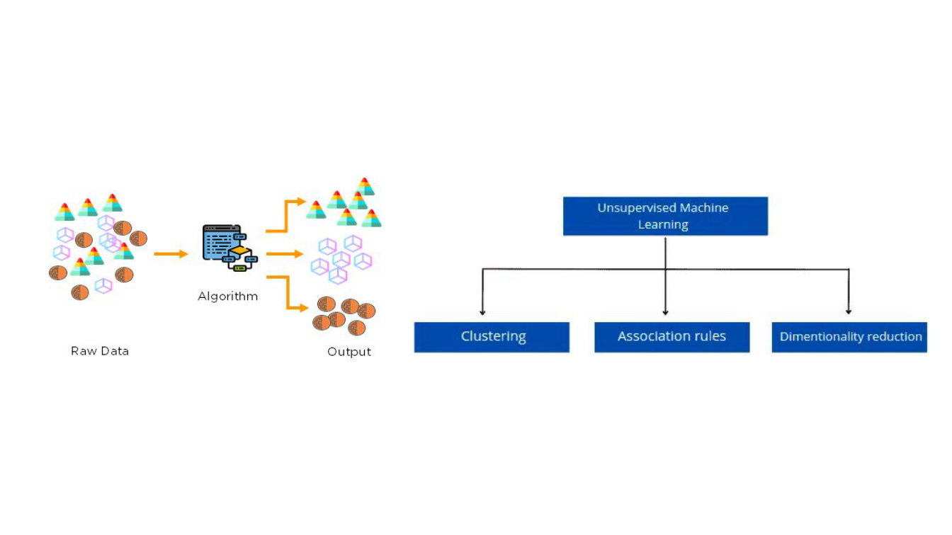
Types of Unsupervised Learning
Source:https://hands-on.cloud/ml-unsupervised-learning-guide/
Source:
https://medium.com/analytics-vidhya/beginners-guide-to-u
nsupervised-learning-76a575c4e942
21

Slide 23

What type of ML problem
do you think it is?
Scenario 1: A bank wants to predict whether a new
applicant will default on a loan. They have data on
previous applicants, including income, credit score, and
past financial behavior.
Question: What type of machine learning problem is
this, and why?
22

Slide 24
What type of ML problem
do you think it is?
Scenario 2: An e-commerce company wants to group its
customers into different segments to better tailor its
marketing strategy. They have information on customer
behavior, such as purchase frequency, spending habits,
and browsing history, but they do not know which
customer belongs to which group.
Question: What type of machine learning problem is
this, and why?
23

Slide 25
What type of ML problem
do you think it is?
Scenario 3: A robotic vacuum learns which actions to take while cleaning a house. It receives positive rewards for cleaning new areas and penalties for collisions or running out of battery.
The robot learns a policy to maximize its total reward over time.
Question: What type of machine learning problem is this, and why?
24

Slide 26
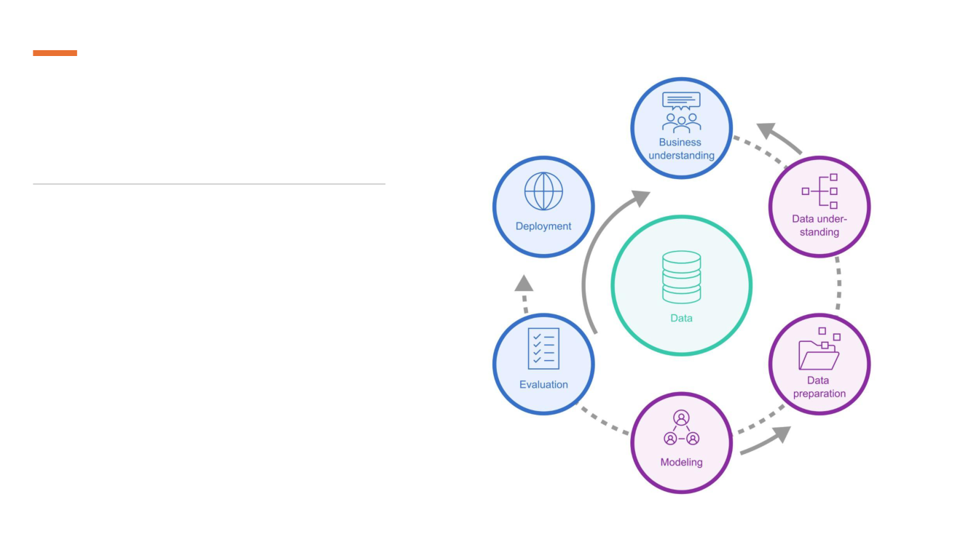
Machine learning
pipeline
Cross-Industry Standard Process for Data
Mining (CRISP-DM)
25

Slide 27
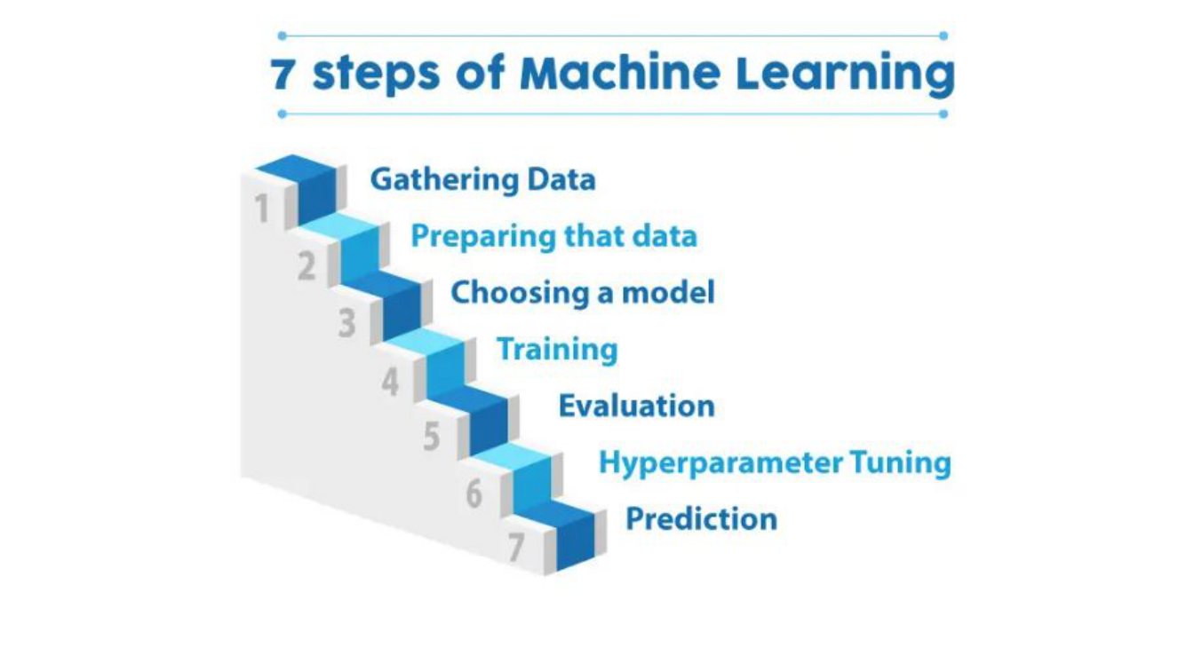
Source: https://www.mygreatlearning.com/blog/what-is-machine-learning/
26

Slide 28
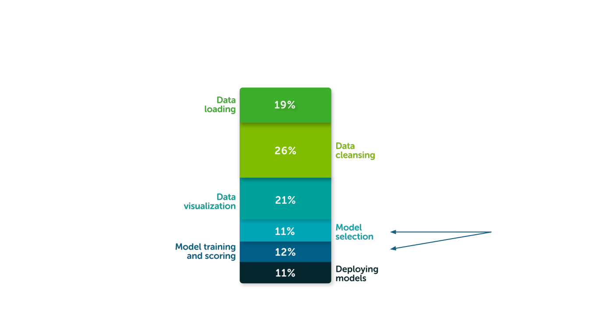
Time allocation for ML tasks
Focus of
this course
Source: https://www.anaconda.com/resources/whitepapers/state-of-data-science-2020
27

Slide 29

Some
practical
Underfitting vs Overfitting
Training, validation, and test dataset
splitting
Cross-validation
Hyperparameter tuning
aspects
Ensemble methods
28

Slide 30
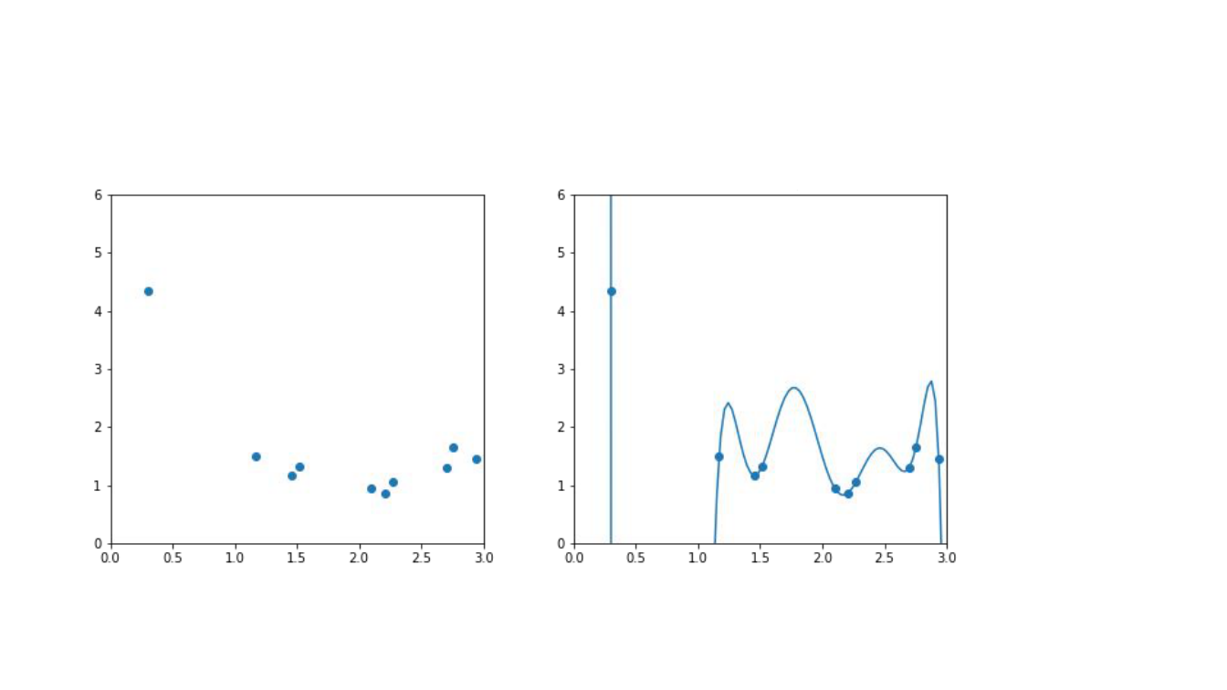
Choosing the function class
29

Slide 31
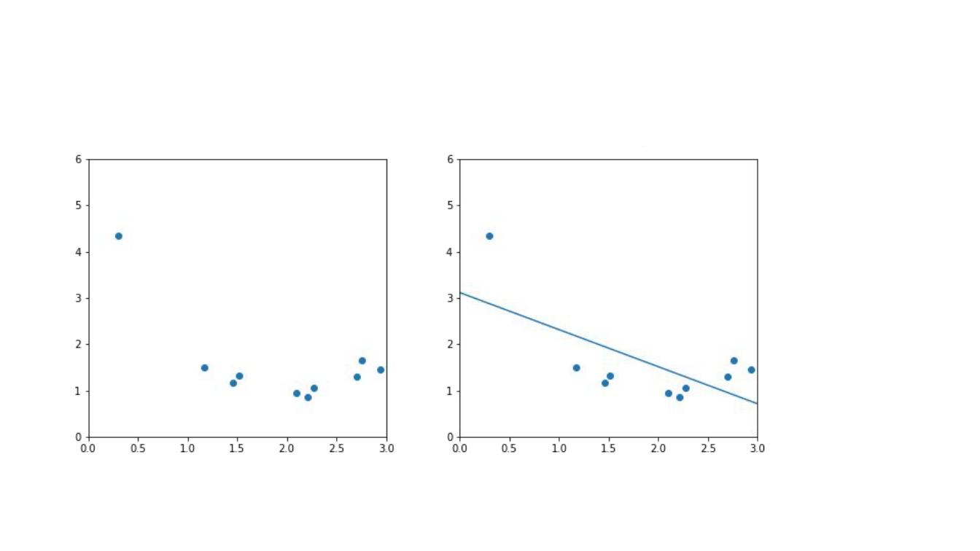
Choosing the function class
30

Slide 32
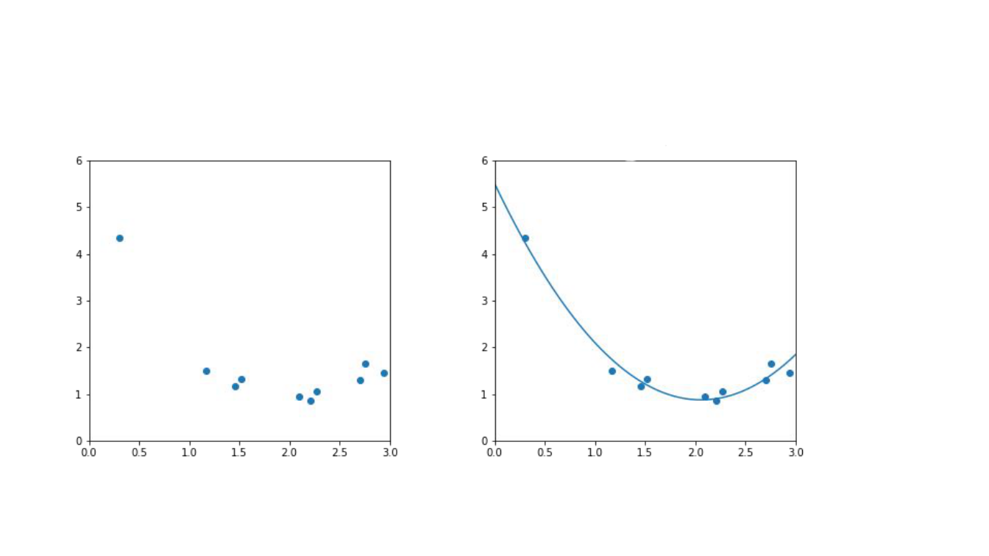
Choosing the function class
31

Slide 33
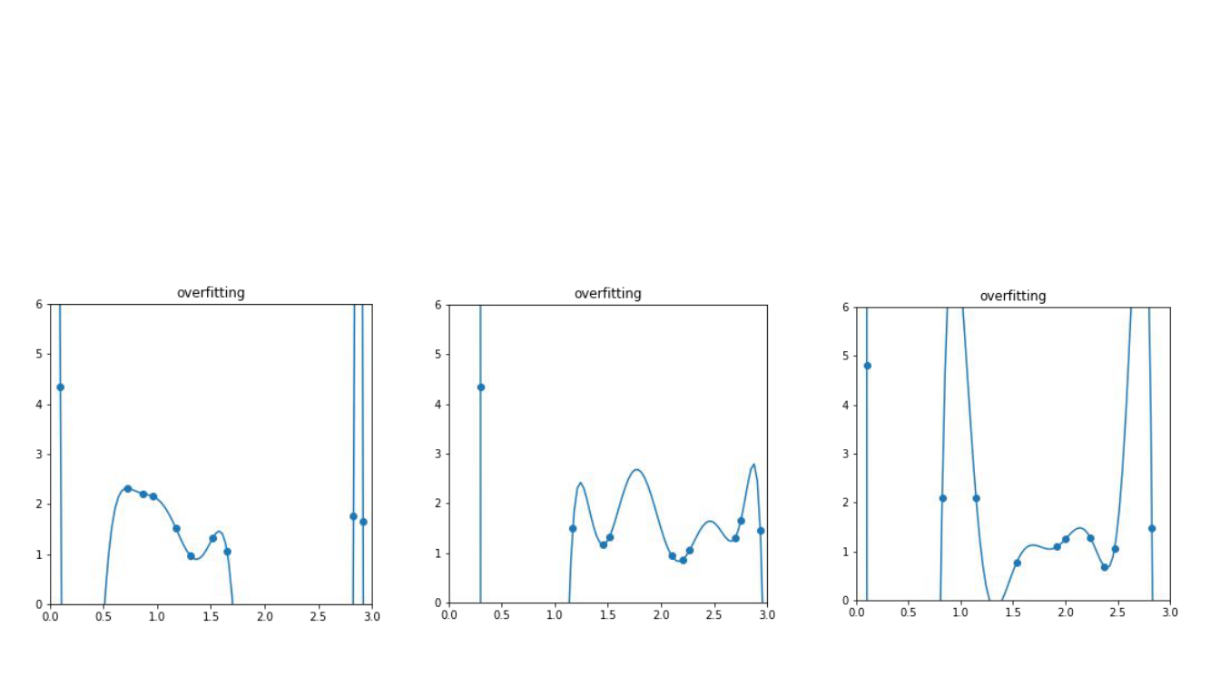
High Variance
Variance is how much the model’s predictions change if you use a different sample of training data
32

Slide 34
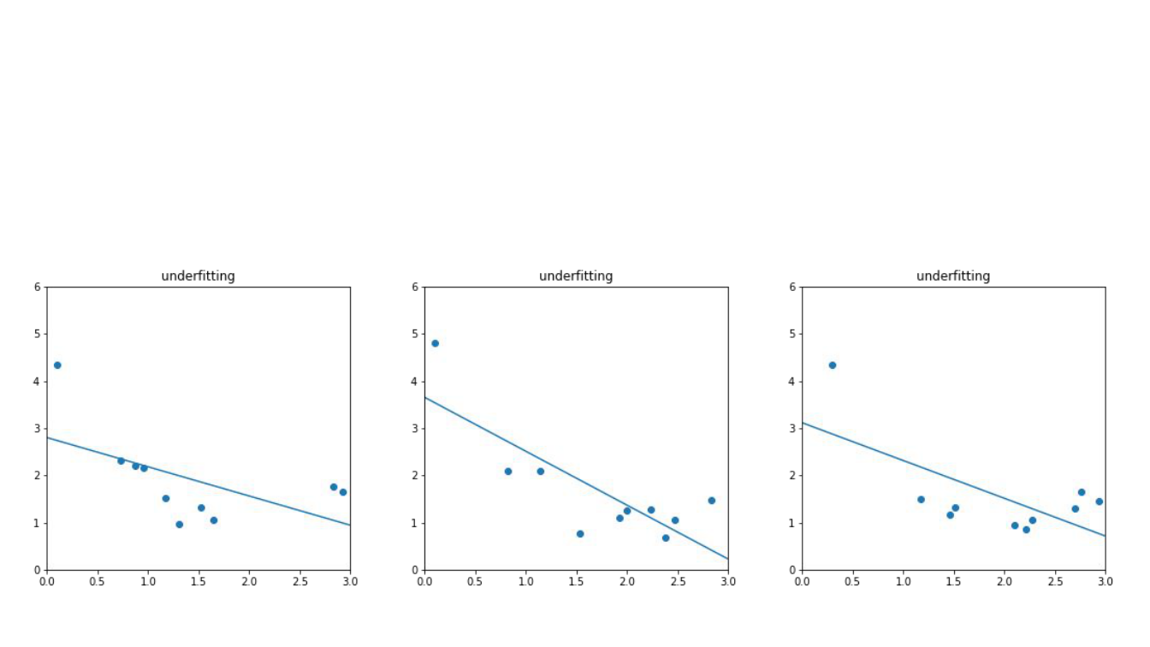
High Bias
Bias is systematic error in predictions, averaged over different training datasets.
33

Slide 35
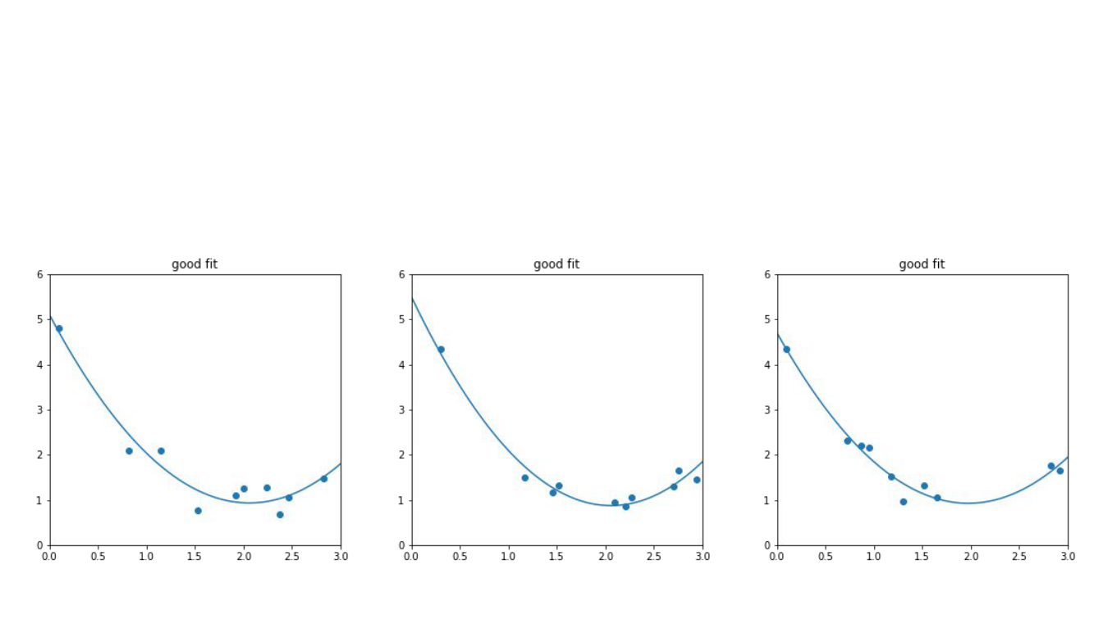
Optimal Bias and Variance
34

Slide 36
Overﬁtting and Underﬁtting
Underfitting
A model is too simple to capture useful patterns. It performs poorly even on the training data and often has high bias.
Overfitting
A model fits training-specific noise or details. Training performance is strong, but performance on unseen data is worse. High variance is a common symptom.
35

Slide 37
Exercise
Scenario 4: A model predicts apartment prices using only size. It consistently misses the higher prices of apartments near the metro, including in the training data.
Question: Does this suggest high bias or high variance?
Scenario 5: A highly flexible model predicts exam scores using study hours, attendance, and many irrelevant features. It fits the training class almost perfectly, but performs poorly on a new class.
Question: Does this suggest high bias or high variance?
36

Slide 38
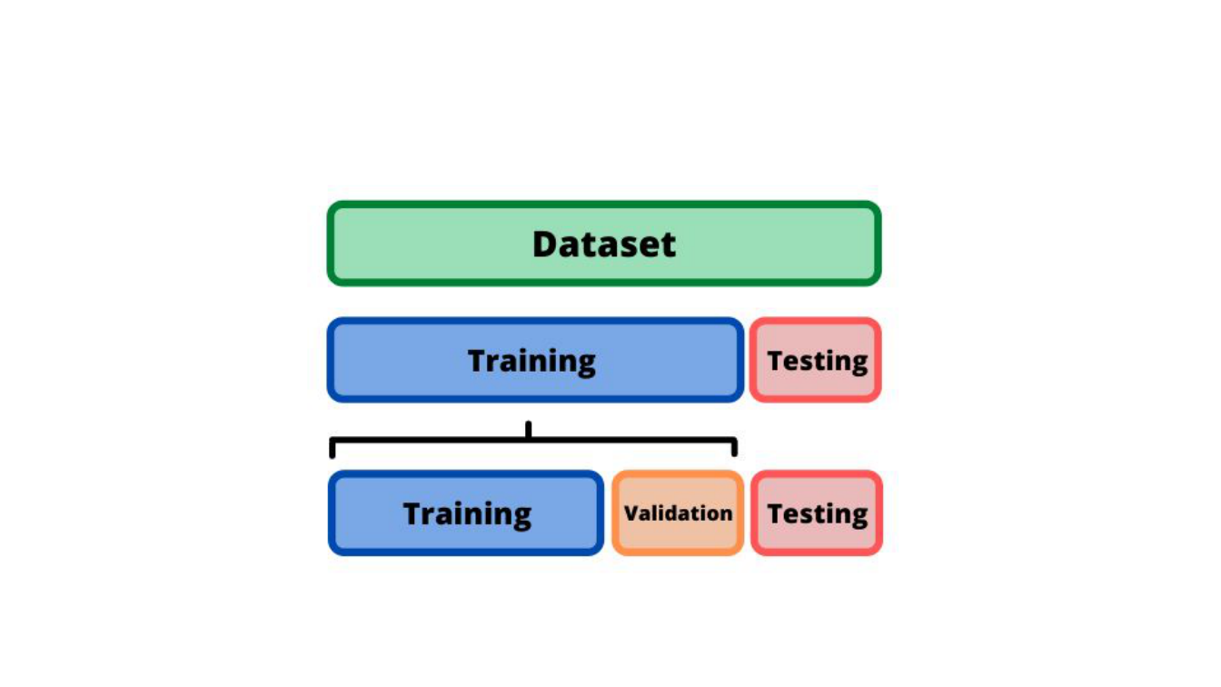
Dataset splitting
Training: fit the model. Validation: select settings. Test: evaluate the final model.
Source: https://dhavalpatel2101992.wordpress.com/2021/05/21/kaggle-titanic-dataset-cleaning-split-data-into-train-validation-and-test-set/
37

Slide 39
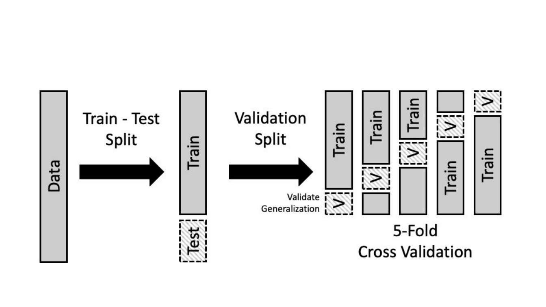
Cross Validation
Tune within the training data using CV. Keep the final test set untouched.
Source: https://learningds.org/ch/16/ms_cv.html
38

Slide 40

Practice
Sources to learn Machine Learning
Lab work
39

Slide 41
Sources to learn ML
Scikit-learn documentation
https://scikit-learn.org/stable/
Kaggle
https://www.kaggle.com/
Machine Learning Mastery
https://machinelearningmastery.com/
Machine learning books
https://github.com/josephmisiti/awesome-machine-learning/blob/master/books.md

Slide 42
Practice
Quiz (required)
The instructor will share the Lecture 1 quiz link.
Lab 01 (required)
https://github.com/Ahsan-ShakoorK/NSU_ML/blob/2026-course/nbs/lab01.ipynb
Pandas exercises (optional)
https://github.com/datasciencelab-ai/100_bai_tap_pandas

Slide 43
References
Machine learning in healthcare
https://acropolium.com/blog/machine-learning-in-healthcare-use-cases-benefits-and-success-stories/
Classification and regression
https://www.enjoyalgorithms.com/blogs/classification-and-regression-in-machine-learning
Unsupervised learning guide
https://hands-on.cloud/ml-unsupervised-learning-guide/
Introduction to unsupervised learning
https://medium.com/analytics-vidhya/beginners-guide-to-unsupervised-learning-76a575c4e942
ML engineer salary: original historical source
https://www.erieri.com/salary/job/machine-learning-engineer/russian-federation
Machine learning job titles
https://www.tealhq.com/job-titles/machine-learning-scientist
Cross-validation
https://learningds.org/ch/16/ms_cv.html

